Slide 1

DSI Capstone Projects Part 1: Pitch & Problem Statement
An Nguyen
04.29.2024

Slide 2

Topic 1: Predictive Modeling for Energy Demand Reduction

Slide 3
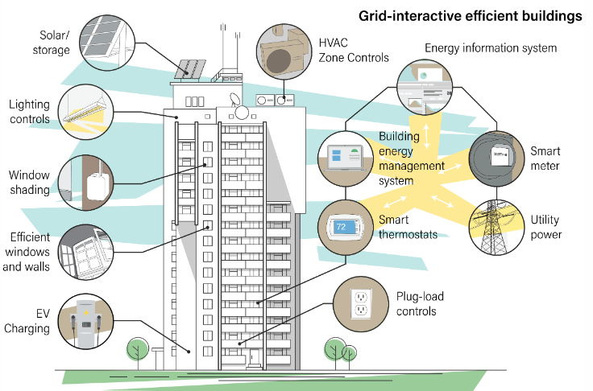
Topic 1: Predictive Modeling for Energy Demand Reduction
Problem Statement: Large office buildings consume significant amounts of energy, leading to high operating costs and environmental impact. Efficient energy management and peak demand predictions can reduce these effects.
Potential Audience: Building managers, energy consultants, utilities companies, companies evaluating hybrid work schedules or new office locations
Goals: Develop a model to predict energy demand peaks and suggest optimal times for energy use reduction based on historical data (by state) and energy-saving scenarios.
Success Metrics: Accuracy of peak demand predictions (RMSE) and percentage reduction in energy consumption.

Slide 4
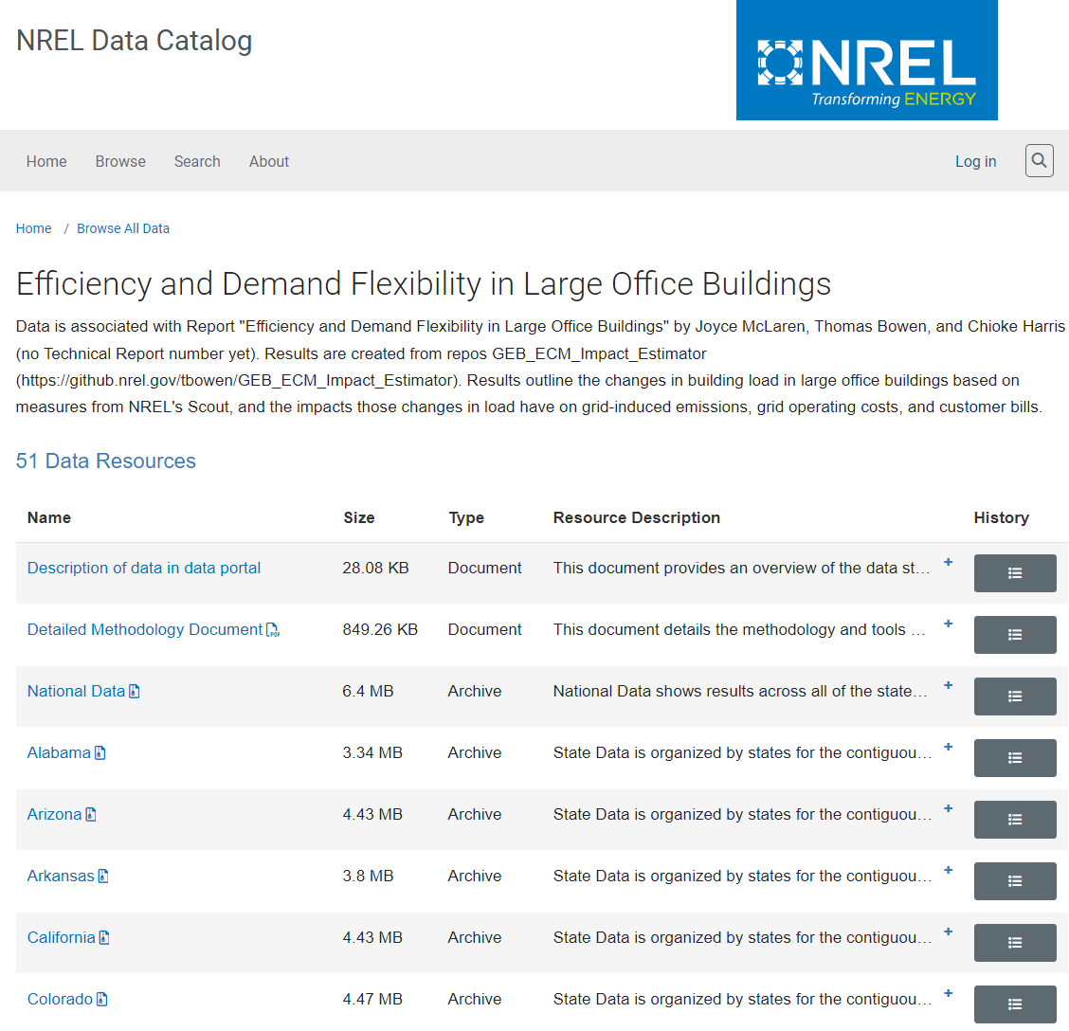
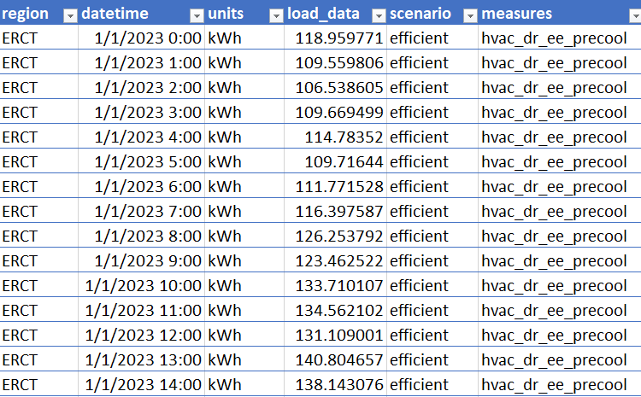
Topic 1: Data sets
Large Building Data Sources:
National Renewable Energy Labotary (NREL) repository provides 51 data sources (national and by state) on building load changes and the effects of various energy conservation measures (ECMs).
Other data sources

Slide 5

Topic 2: Virtual Reality Products Sentiment Analysis

Slide 6


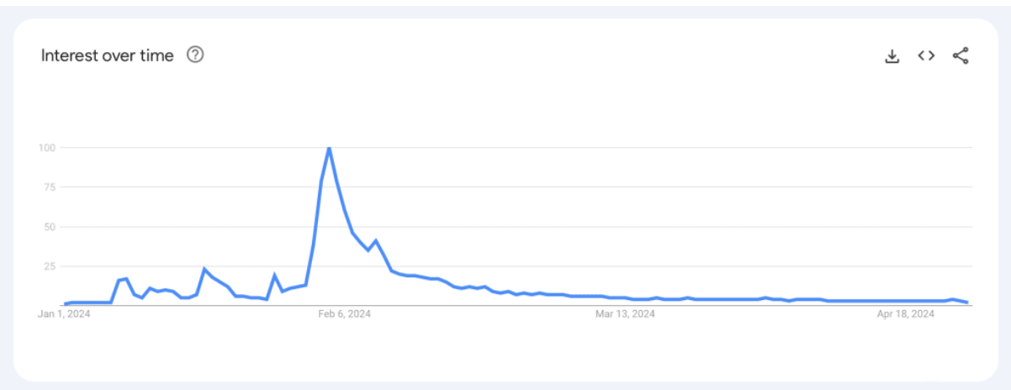
Topic 2: Virtual Reality Products Sentiment Analysis
Problem Statement: With VR technology advancing, understanding public sentiment and interest trends is crucial for businesses looking to invest in or develop VR products.
Potential Audience: VR technology companies, game developers, investment analysts, consumers,
Goals: Analyze user-generated data on social media to track sentiment and trends on Apple Vision Pro and Meta Quest VR headsets over time.
Success Metrics: Accuracy of sentiment analysis (manually annotate a data subset), key words mentioned over time, correlation of sentiment trends with product sales.

Slide 7


Topic 2: Data sets
Scraping user-generated contents on social media sources:
Scrape subreddits focusing on VR technology using PRAW.
Scrape X.com data using X API (free or paid versions)
Other social media platforms (truth social?)
Technology/marketing podcasts transcripts

Slide 8

Topic 3: Autonomous Vehicle Disengagement Analysis

Slide 9
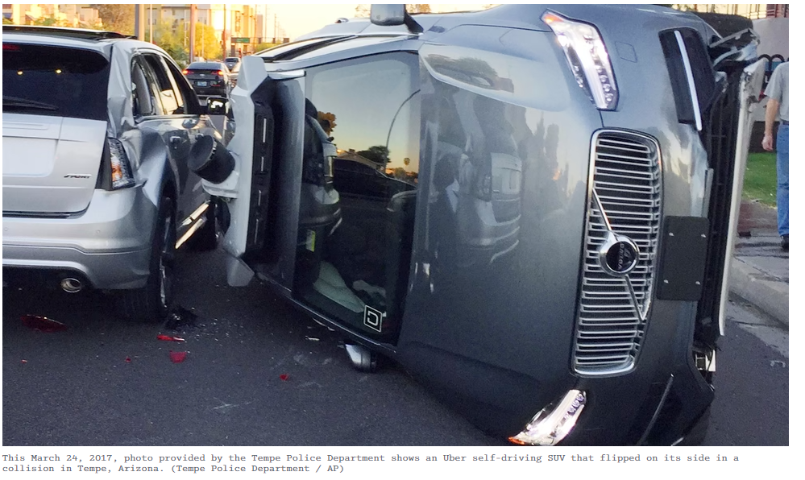
Topic 3: Autonomous Vehicle Disengagement Analysis
Problem Statement: Understanding the reasons behind autonomous vehicle disengagements is vital to improving self-driving technology and ensuring safety on public roads in California.
Potential Audience: Autonomous vehicle manufacturers, lawyers, safety regulators in California and other states.
Goals: Develop an NLP model to analyze patterns in disengagement reports, identifying common causes and potential correlations with environmental factors or vehicle types.
Success Metrics:
The frequency and distribution of disengagement type
Trends or patterns in AV disengagements per year
Correlation coefficients between disengagements and vehicle models.

Slide 10
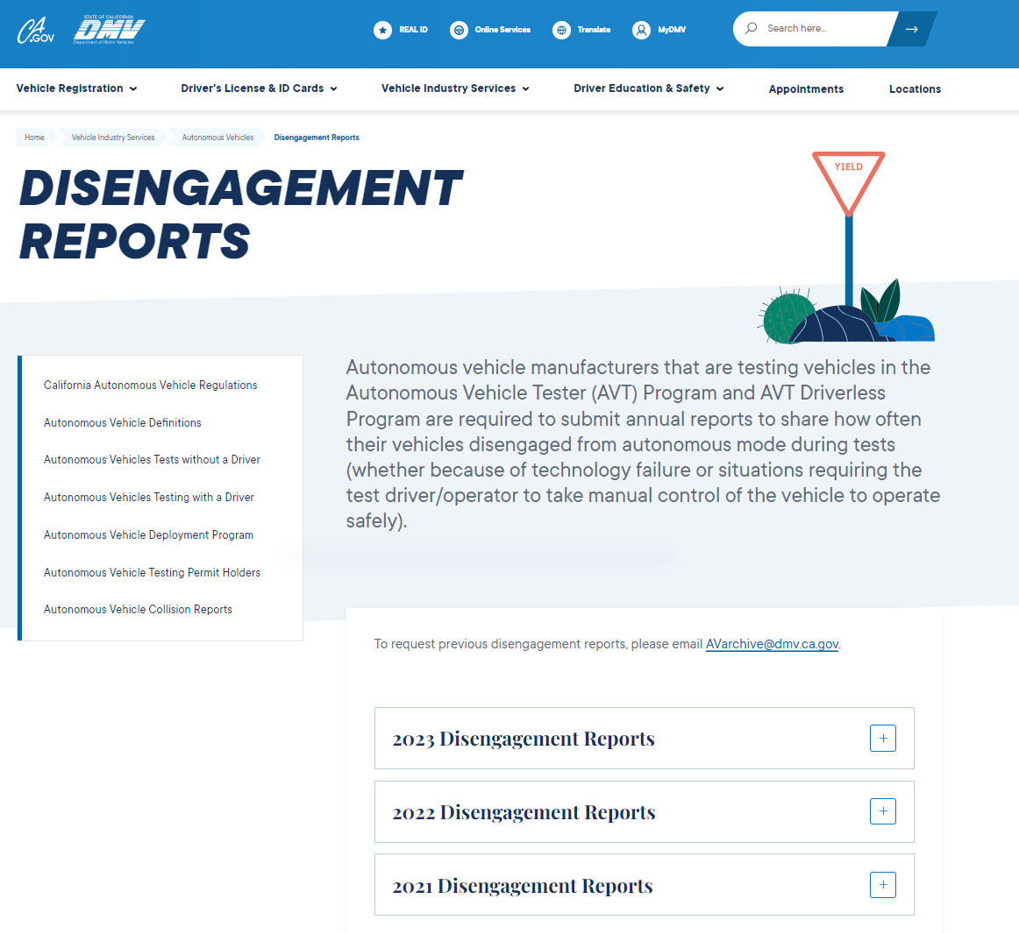
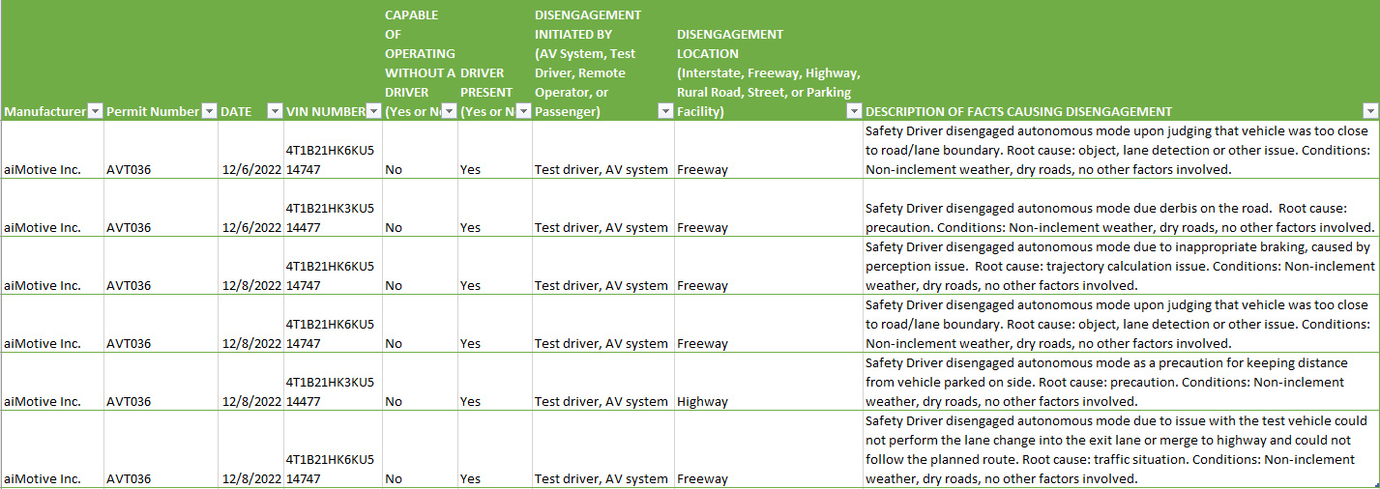
Topic 3: Data set
California DMV Disengagement Reports
Autonomous vehicle manufacturers and AV tester programs in California are required to submit annual reports to California on AV disengagement incidents
Data in each record:
manufacturer, permit number, date, vehicle identification number (VIN), whether a driver was present, who initiated the disengagement, the location type, disengagement incident description.
Records are aggregated into annual incident reports (csv format) for 2021, 2022, and 2023.

Slide 11
Thank you

